Slide 1

Multi Disease Prediction using Chest X-Rays
Priyadharshini S 20BCE1016 Shubhangi Agrawal 20BCE1161 Shrishti Singh 20BCE1164

Slide 2
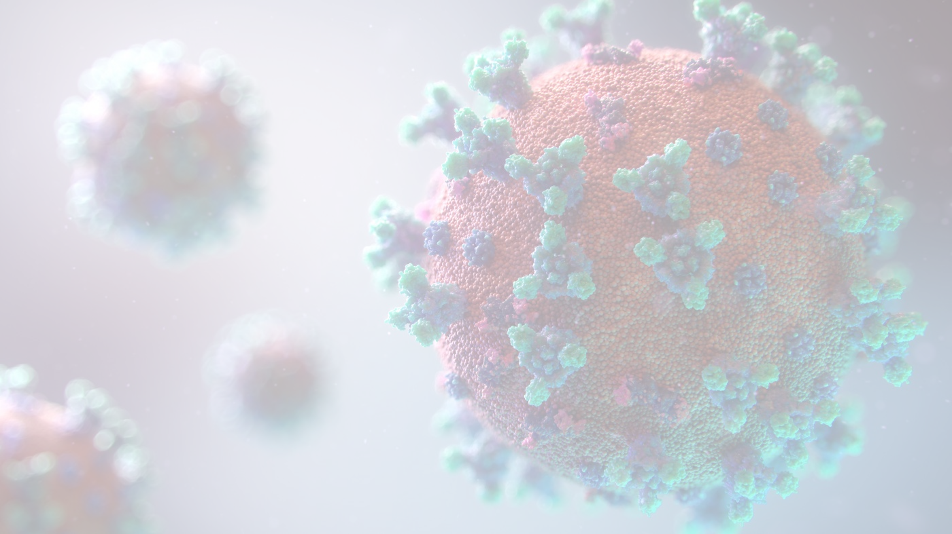
Objective
Medical image analysis is a crucial area in the field of healthcare, with the potential to improve patient outcomes by enabling early detection and diagnosis of diseases.
The main objective of the project is Multi Disease Prediction by Chest Xray using transfer Learning.

Slide 3
Introduction
Medical image analysis is a crucial area in the field of healthcare, with the potential to improve patient outcomes by enabling early detection and diagnosis of diseases.
Chest X-rays are among the most commonly performed imaging tests in clinical practice and can provide valuable information about various respiratory and cardiovascular diseases, such as pneumonia, tuberculosis, and lung cancer. However, the interpretation of chest X-rays can be challenging, particularly for complex cases where multiple diseases coexist or where there are subtle abnormalities.
Traditional image analysis techniques rely on manually crafted features, which can be time-consuming and subjective.

Slide 4
In contrast, deep learning techniques, particularly convolutional neural networks (CNNs), have shown great potential for automated medical image analysis.
These models can automatically learn features from the images, without the need for human intervention, and have achieved remarkable success in various tasks, such as classification, segmentation, and detection.
Transfer learning is another approach that has significantly enhanced the performance of CNNs in medical image analysis. Transfer learning involves leveraging pre-trained models on large datasets to perform new tasks with limited training data.
This approach has been shown to improve the performance of CNNs and reduce the need for large amounts of labeled data, which can be challenging to obtain in medical imaging tasks.

Slide 5
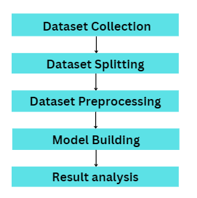
Proposed Methodology

Slide 6
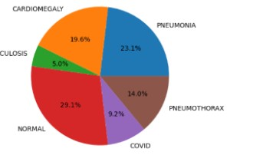
Dataset Collection:
The dataset used for the model used in this research is extracted from Kaggle which is into 6 folders for the 5 diseases and normal category scans There are 13,900 X-Ray images (JPEG, PNG & JPG) and 6 categories (Cardiomegaly,Covid,Normal, Pneumonia, Pneumothorax, Tuberculosis ).
The link of the dataset used is given below: https://www.kaggle.com/datasets/baro1502/chest-xray
The distribution of each category is as depicted below:

Slide 7
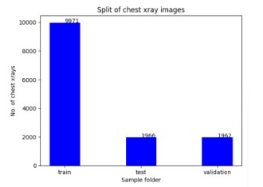
Dataset Splitting:
The dataset was splited into three sets namely test, train and validation. Training set contains 9971 images, testing set contains 1966 image and the validation set contains 1962 images each belonging to 6 classes after the split.
The bargraph showing the split is given below:

Slide 8
Dataset Preprocessing:
Rescaling: The pre-trained CNN model VGG19 inputs a color image of dimensions 224×224, while InceptionV3 requires input dimensions to be 299x299, on the other hand ResNet50 requires the input image of size 300x300. However, all the images of the dataset are of different dimensions. Hence, they were all resized to the required dimension, for the different models.
Normalisation:Normalization has also been performed on the data so that the effect of illumination can be reduced from the X-ray scanned images. The images belonging to both the classes, i.e., “Pneumonia” and “Normal” were visualized, which made it clear that the data is imbalanced, so we used image augmentation to get a better distribution of data and prevent overfitting and thus making our model more robust.
RGB to gray scale conversion: The images were converted to Grayscale,to reduce the complexity of the image by removing color information and representing the image in a simpler, more compact form. This can make it easier to process and analyze the image, particularly in situations where color information is not necessary or relevant.

Slide 9
Model Building:
CNN with Resnet50, VGG19 and InceptionV3 architecture was built to train the dataset. CNN:A deep learning CNN consists of three layers: a convolutional layer, a pooling layer and a fully connected (FC) layer. The convolutional layer is the first layer while the FC layer is the last. From the convolutional layer to the FC layer, the complexity of the CNN increases. It is this increasing complexity that allows the CNN to successively identify larger portions and more complex features of an image until it finally identifies the object in its entirety.
Resnet50:ResNet's architecture is built on the idea of residual learning, which learns the residual function rather than the actual mapping. By utilizing shortcut connections, which enable the input to skip one or more levels and go straight to the output, ResNet accomplishes this. ResNet's design can be seen as a collection of residual blocks, where each block houses a stack of convolutional layers connected by shortcuts.

Slide 10
VGG19: The VGG19 model is composed of 19 layers, including 16 convolutional layers and 3 fully connected layers. The convolutional layers are grouped into 5 blocks, where each block consists of multiple convolutional layers followed by a max pooling layer. The number of filters in each convolutional layer is fixed to 64, except for the first convolutional layer which has 3 channels to match the RGB input images.
InceptionV3: Inception v3 is a popular convolutional neural network (CNN) architecture that is often used in transfer learning for image recognition tasks. One of the key features of Inception v3 is its use of "inception modules," which are sets of convolutional layers with varying filter sizes that are concatenated together to capture features at different scales. This allows the model to learn more complex and diverse features compared to traditional CNN architectures.

Slide 11
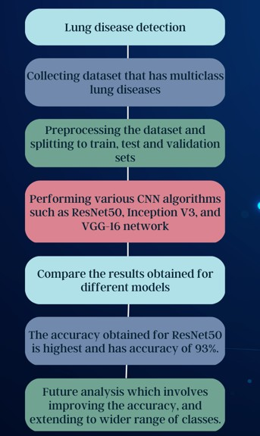
WORKFLOW

Slide 12
Result : The following table depicts the results of each model, with different optimizers, epochs and batch sizes.
Method | Optimizer used | Batch size | No. of Epochs | Training accuracy | Test accuracy
ResNet50 RGB | Adam | 32 | 30 | 96.44 | 93.03
ResNet50 GrayScale Inception V3 | Adam Adam | 32 32 | 30 20 | 97.24 98.32 | 93.34 90.69
VGG-19 | Adam | 32 | 10 | 97.12 | 91.65
VGG-19 | Adam | 32 | 15 | 97.98 | 91.14
VGG-19 | Adam | 64 | 20 | 97.79 | 92.17
VGG-19 | RMSprop | 32 | 10 | 95.91 | 91.71
VGG-19 | RMSprop | 64 | 12 | 92.13 | 87.79
CNN | Adam | 32 | 30 | 94.04 | 87.74

Slide 13
Result analysis:
The Resnet50 model achieved the highest training accuracy of 97.24% among all the models, but its test accuracy was slightly lower at 93.03%. This model performed well in grayscale, indicating that grayscale normalization helped to reduce the impact of variations in illumination, making the model more robust.
The Inception V3 model achieved the highest test accuracy of 90.69%, but its training accuracy was higher than the test accuracy, indicating that it may have overfitted the data. This model required a larger input image size of 299x299, which may have contributed to the overfitting. The model was also trained with a smaller number of epochs (20) compared to other models.
The VGG19 model achieved moderate accuracy, with its highest accuracy achieved with a batch size of 64 and an epoch of 20, reaching 92.17%. However, the model was not able to achieve a high accuracy compared to other models.

Slide 14
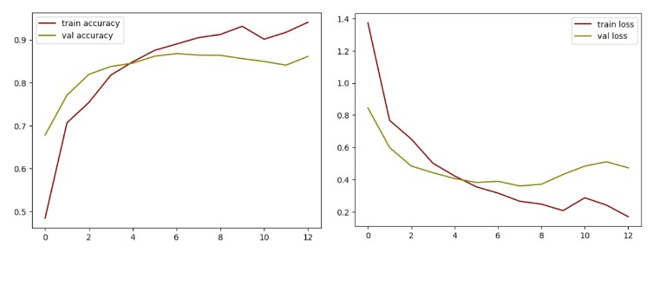
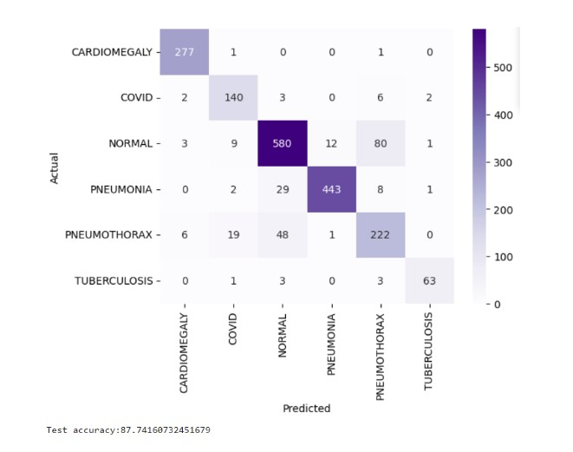
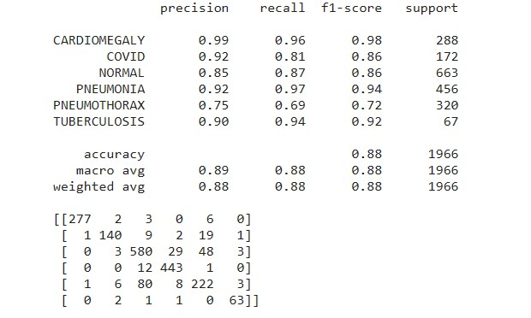
CNN

Slide 15

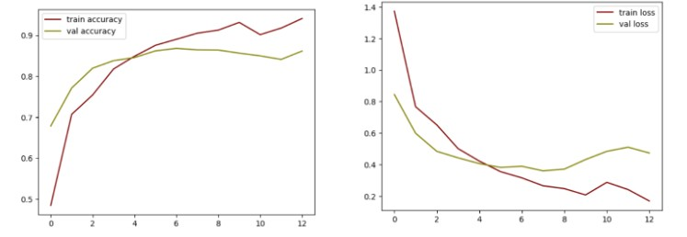
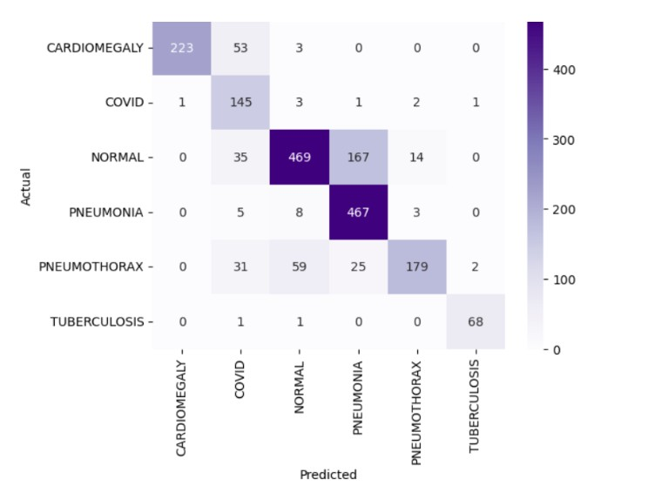
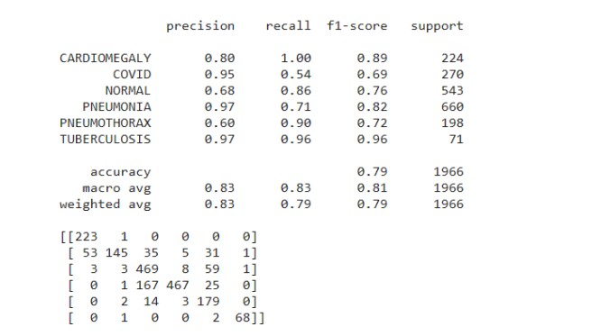
ResNet50 RGB model

Slide 16
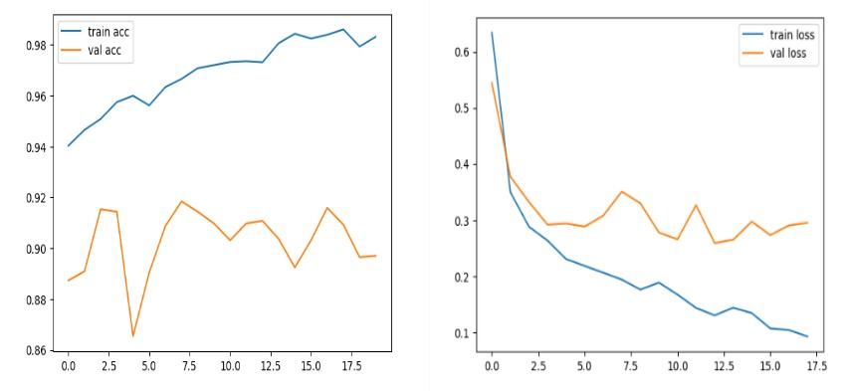
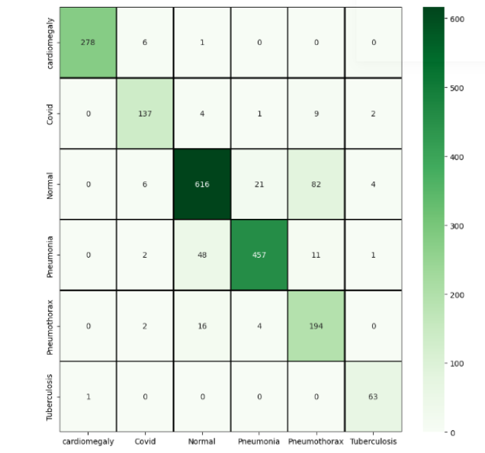
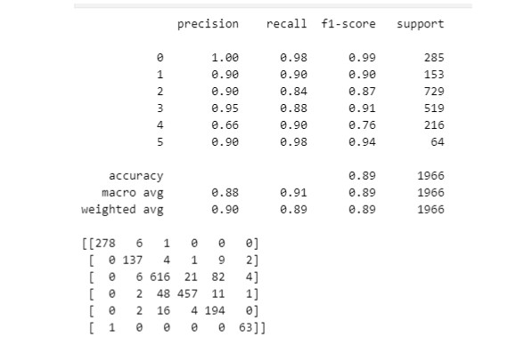
Inception V3

Slide 17
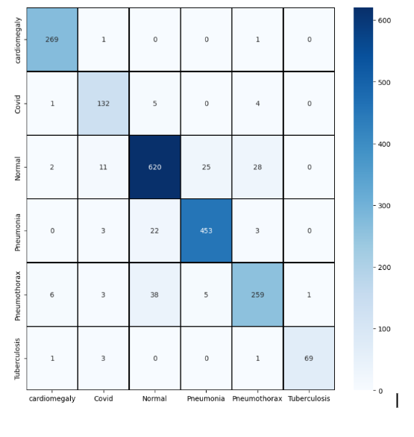
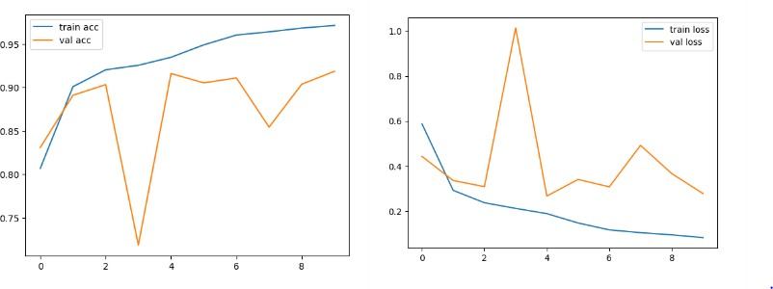
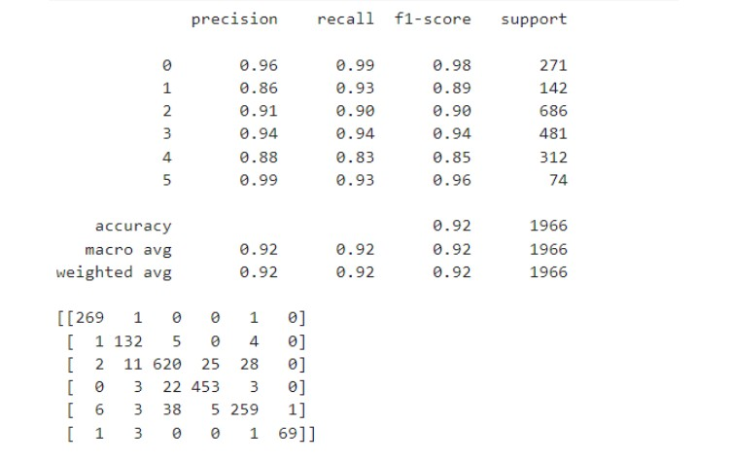
VGG-19

Slide 18
Conclusion
In conclusion, we have implemented deep CNNs and transfer learning techniques for multi-disease prediction using chest X-rays. We utilized three pre-trained models, VGG19, Resnet50 and InceptionV3, along with a CNN built from scratch to classify six categories - Cardiomegaly, Covid, Normal, Pneumonia, Pneumothorax, and Tuberculosis. The dataset was preprocessed to ensure that the images were scaled, normalized, and converted to grayscale to make them suitable for model implementation. The dataset was also split into training, validation, and testing sets for the purpose of training, hyperparameter tuning, and testing. Our model achieved high accuracy rates ranging from 87.74% to 93.34%, with Resnet50 grayscale achieving the highest accuracy.
While our results are promising, further research can be conducted to improve the accuracy and generalizability of the model. More comprehensive data augmentation techniques could be employed to increase the size and diversity of the dataset, and the model can be fine-tuned to increase its sensitivity and specificity for different disease classes. Additionally, the model's performance can be evaluated on larger datasets, and more advanced deep learning architectures can be explored for even better performance. Overall, our study demonstrates the potential of deep CNNs and transfer learning in accurately classifying chest X-rays and holds promise for clinical applications in the future.

Slide 19
Thank You

